Slide 1

Data Storytelling & Decision Making for Managers
Developed & Copyrighted by
Emirates Institute of Finance (EIF)

Slide 2


Course Hours:
Weekdays (Monday to Thursday): 9:00 AM - 2:00 PM
Fridays: 8:00 AM - 12:00 PM
Breaks:
Two short breaks during each session, approximately 15 minutes each.
Course Material:
All course material can be downloaded via EIF LMS.
Attendance Policy:
Attendance will be recorded during three sessions.
Participants must be present within the first 15 minutes of each session.
Feedback Submission:
Participants must submit feedback online at the end of the course; failure to do so will result in certificate denial.
Certificate Denial :
For 1-day programs, being more than 15 minutes late will lead to certificate denial. For 2/3-day programs, missing more than one session will result in certificate denial.
Failure to complete the mandatory feedback form will also result in certificate denial.
Certificate Delivery:
Certificates for the course will be shared via email.
Support & Contact:
For any registration or attendance-related issues, please reach out to the Registration team.

Slide 3

How to complete course feedback
Go to https://live.eibfs.ae or scan the QR code.
Log in using your username and password.
Find your course by its title.
Click on the “Feedback”
Complete the survey.
Feedback form completion is a mandatory requirement to receive the certificate.

Slide 4

EIF
List of International Certifications

Slide 5



About
Training Program
Learning Outcomes
Course Features
After the completion of this course, the learners would be able to:
1. Understand the art and science of storytelling and decision making.
2. Create compelling visualizations required for storytelling with data.
3. Learn to maximize use of tools for effective story telling.
4. Craft stories with a beginning, middle and the end on any data for effective decision making.
Learning
Methodology
Hands-on
Activities
Assessment
Strategy

Slide 6
Data Essentials

Slide 7

Data Essentials
Text to Columns
Cell Formatting Secrets
Building Lists
Excel Tables and Aggregates
Detecting Outliers
Conditional Aggregates without Pivots

Slide 8
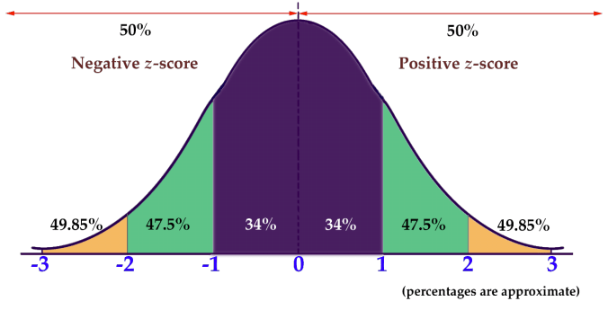
Z-Score Chart

Slide 9
Good or Bad Visuals?

Slide 10
Exercise: Make “charts”
Sales Revenue by Category
Yearly Total Profits
Product Price by Customer Ratings
Categories | Sales Revenue
Furniture | 853169
Office Supplies | 719047
Technology | 836154
Year | Total Profit
2018 | 45300
2019 | 43383
2020 | 45256
2021 | 69505
2022 | 52749
2023 | 30201
Banks | Product Fee | Customer Ratings
Bank 1 | 1200 | 4.9
Bank 2 | 1000 | 3.2
Bank 3 | 900 | 4.0
Bank 4 | 1000 | 4.2
Bank 5 | 800 | 3.8
Bank 6 | 500 | 3.9
Bank 7 | 600 | 4.1
Bank 8 | 500 | 4.6
Bank 9 | 400 | 3.7
Bank 10 | 800 | 2.5
Notes:
This slide presents three data tables (Sales Revenue by Category, Yearly Total Profits, Product Price by Customer Ratings). The aim of the exercise is to transform this raw data into more effective and insightful charts.
Key Principles to Apply (Based on "Storytelling with Data"):
Choose the Right Chart Type:
For "Sales Revenue by Category," a bar chart is ideal. It allows for easy comparison between categories (Furniture, Office Supplies, Technology).
For "Yearly Total Profits," a line graph would clearly depict trends over time (from 2018 to 2023), making it easier to spot growth or decline.
For "Product Price by Customer Ratings," a scatter plot or a bubble chart could highlight any correlation between product fee and customer satisfaction, making patterns more apparent than a table.
Simplify and Remove Clutter:
When creating charts, remove unnecessary gridlines and labels to keep the visuals clean and focused.
Focus on only the necessary labels that help convey the key message. For instance, highlighting the top-performing year in profits or the best-rated product fee can help guide the viewer's attention.
Use Color Wisely:
Leverage color to draw attention to key data points. For example, use a distinct color to highlight the highest customer rating (Bank 1) and lowest (Bank 10) in the third table.
In the profit trend, you could highlight the year with the highest profit (2021) using a standout color.
Tell a Story with the Data:
Guide the audience through the insights: What is the reason for the peak in 2021 profits? Why is technology the highest revenue category? Are higher fees leading to better customer ratings?
Use Annotations for Key Insights:
Consider annotating important data points directly on the charts once created, such as calling out 2021 as a standout year for profits or noting the top-rated banks in the customer rating dataset.

Slide 11
Why do we make “bad charts”?
Notes:
Why this is a bad chart:
3D Pie charts distort perception, making it difficult to accurately compare the slices.
Percentages like 64% (green) dominate visually, but smaller categories (like 4%) are hard to compare.
Pie charts make it hard to judge relative sizes, especially with more than a few categories.
Recommendation: Use a bar chart instead for clearer comparison between satisfaction levels.

Slide 12
Why do we make “bad charts”?
Notes:
Why this is a bad chart:
Stacked bar charts make it difficult to compare individual groups across categories (UAE Population vs No of Customers).
It's hard to interpret the distribution within each group, especially for smaller categories like Group 5 and Group 7.
Recommendation: Use side-by-side bar charts or another chart type that allows for easier comparison of individual groups.

Slide 13
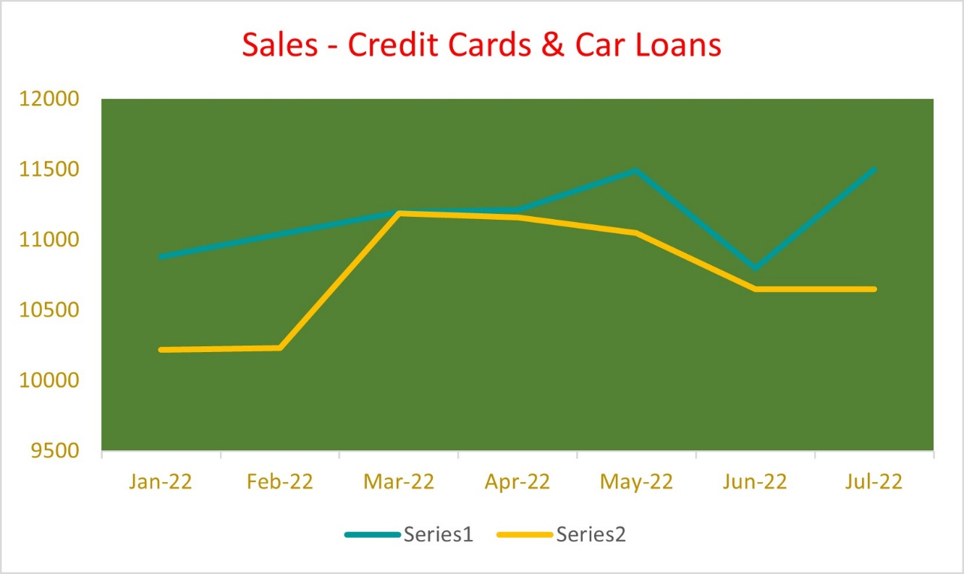
Why do we make “bad charts”?
Branch | Jan | Feb | Mar | Apr | Jun
Abu Hail | 9 | 8 | 9 | 8 | 7
Majaz | 8 | 9 | 2 | 9 | 9
Jumeirah | 9 | 8 | 3 | 8 | 7
SAIF Zone | 2 | 5 | 8 | 2 | 4
Musafa | 7 | 6 | 8 | 8 | 7
Ajman City Centre | 8 | 9 | 6 | 8 | 7
Al Medan | 8 | 9 | 7 | 8 | 8
Business Bay | 4 | 8 | 2 | 9 | 8
Jebel Ali | 9 | 8 | 9 | 7 | 9
Notes:
Why this is a bad chart:
The line chart on the left lacks clarity in conveying the difference between Series 1 and Series 2; the lines are too close and colors don't create enough contrast.
The table on the right is dense and hard to read, making it difficult to draw quick insights from the data over time.
Recommendation: For the line chart, adjust colors for better contrast and consider adding markers or labels. Replace the table with bar charts for easier comparison of branch performance over months.

Slide 14
“ We are not good at storytelling naturally.”
But the good news is, we can learn and become an excellent storyteller.”
Notes:
Key Message: Storytelling is a learned skill, not an innate talent.
Focus: Encourage the audience by emphasizing that although storytelling with data may not come naturally, it can be mastered through practice and learning.

Slide 15






How you’ll learn storytelling with data?
Show designing skills
Know the context
Choose appropriate visuals
Direct audience’s focus on your visuals
Remove clutter from visuals
Tell your story
Notes:
Notes:
Key Steps in Learning Storytelling with Data:
Know the context – Understand the data and its significance.
Choose appropriate visuals – Select charts or graphs that best represent the data.
Remove clutter from visuals – Simplify visuals to enhance clarity.
Direct audience’s focus – Use design techniques to highlight key insights.
Show designing skills – Ensure visuals are not only functional but also visually appealing.
Tell your story – Use the data visuals to narrate a compelling and insightful story.

Slide 16



Storytelling is not tool specific
Notes:
Key Message: Storytelling with data is not dependent on specific tools.
Tools Represented: Excel, Power BI, and PowerPoint.
Focus: The principles of effective storytelling can be applied across various tools, whether creating visuals in Excel, Power BI, or presenting them in PowerPoint. The tool is secondary to the storytelling approach.

Slide 17
Know the context
Notes:
Key Message: Understanding the context is crucial before visualizing data.
Focus: Know the background, audience, and purpose of the data to ensure the story told aligns with the insights that matter most. This step is foundational for effective storytelling with data.

Slide 18
Know the context
Take time to understand the context of sharing information.
Exploratory Analysis vs Explanatory Analysis.
Exploratory Analysis – Understanding data & figuring out what’s interesting to highlight.
Explanatory Analysis – Picking the most interesting story you want to tell.
How Explanatory Analysis should be conducted?
Notes:
Exploratory Analysis: Used to understand the data and identify interesting patterns.
Explanatory Analysis: Focuses on presenting the most compelling story derived from the data.
Focus: Emphasize the importance of knowing the context before deciding what data story to tell and how to structure the analysis.

Slide 19
Know the context
Ask yourself 2 Questions first?
Who: To whom are you communicating ?
What: What do you want your audience to do or know?
Who: Consider Audience & You.
What: Consider Action, Mechanism, and Tone.
Then ask the third question.
3. How can you use data to make your point?
Notes:
Key Questions for Understanding Context:
Who: Identify your audience and their needs.
What: Define the action or knowledge you want your audience to take away.
How: Determine how data can be used to effectively support your point.
Focus: Emphasize the importance of audience, desired outcomes, and the role of data in communication.

Slide 20
Know the context – Case Study
Imagine you're a marketing manager at a bank. You recently concluded a trial weekday campaign promoting a specific banking product, an offering often overlooked by potential customers. To gauge its impact, you conducted surveys at the campaign's start and finish, revealing a positive shift in perceptions. You believe the data shows a great success story. You would like to continue to offer the weekday campaign going forward. "Find the Who, What and How?
Who: The budget committee that can approve funding for continuation of the weekday campaign.
What: The weekday campaign on the unpopular banking product was a success, please approve budget of AED X amount to continue.
How: Illustrate success with data collected through survey conducted before and after the trial weekday campaign.
Notes:
Notes:
Case Study Focus: Applying the "Who, What, How" framework to a marketing scenario.
Who: The budget committee responsible for approving campaign funding.
What: Convince the committee that the trial weekday campaign was successful and should continue with a proposed budget.
How: Present survey data showing the positive impact of the campaign before and after the trial.

Slide 21
Know the context
3-minute story: “I would have written a shorter letter, but I did not have the time.”
Big Idea: Boil down the entire story to a single sentence by articulating your unique point and conveying what’s important.
Storyboarding: A visual outline of the content you plan to create.
Issue
Demonstrate Issue
Ideas for overcoming issue
Describing Solution
Showing data to demonstrate success
Recommendation
Notes:
Key Concepts:
3-minute story: Simplify and focus your message to save time.
Big Idea: Condense the story into a single, powerful sentence.
Storyboarding: Visually plan out your content to guide the storytelling process.
Storyboard Outline:
Issue
Demonstrate Issue
Ideas for Overcoming Issue
Describing Solution
Showing Data to Demonstrate Success
Recommendation

Slide 22
Recap what we learned…
Before creating any visualization, know about the context.
Exploratory and Explanatory Analysis.
Few Important considerations for Explanatory Analysis: Who? What? & How?
3-minute story and the Big Idea.
Storyboarding
Notes:
Recap of Key Lessons:
Importance of understanding context before visualizing data.
Difference between Exploratory and Explanatory Analysis.
Framework for Explanatory Analysis: Who? What? How?
The 3-minute story technique and identifying the Big Idea.
Using storyboarding to plan the structure of your data story.

Slide 23
Choose appropriate visuals
Notes:
Key Message: The choice of visual should align with the type of data and the story you want to tell.
Focus: Select visuals that clearly convey your message, such as bar charts for comparisons, line charts for trends, and scatter plots for correlations. The right visual aids in delivering insights more effectively.

Slide 24
Choose appropriate visuals
A. Simple Text – When you have a number or two to share, simple text can be a great way to communicate.
Customer confidence in the banking sector in the UAE rose to 90 percent in 2023, compared to 84 percent in 2022.
Ref: zawya.com article “'Sanadak' launch a leap forward for UAE financial services: UAE Banks Federation” dated 11.03.2024.
Notes:
Simple Text and Visuals:
When presenting a few key numbers, such as 84% in 2022 and 90% in 2023, simple text combined with a basic visual (like a bar chart) can be effective.
Focus: Keep the visuals clean to emphasize the increase in customer confidence from 2022 to 2023 in the banking sector. Simple, direct visuals work well when the message is straightforward.

Slide 25
Choose appropriate visuals
A. Simple Text – When you have a number or two to share, simple text can be a great way to communicate.
90%
Customer confidence in the banking sector in the UAE in 2023 vs. 84% in 2022.
Ref: zawya.com article “'Sanadak' launch a leap forward for UAE financial services: UAE Banks Federation” dated 11.03.2024.
Notes:
Simple Text Example:
Emphasizes the 90% customer confidence in 2023 versus 84% in 2022.
Focus: This approach uses minimal text and large, bold numbers to communicate the key takeaway effectively. It's a clear, impactful way to highlight important data with simplicity.

Slide 26
Choose appropriate visuals
B. Tables – Tables interact with our verbal system, which means that we read them.
Performance score of branches from Jan to Jun 2023.
Branch | Jan | Feb | Mar | Apr | Jun
Abu Hail | 9 | 8 | 9 | 8 | 7
Majaz | 8 | 9 | 2 | 9 | 9
Jumeirah | 9 | 8 | 3 | 8 | 7
SAIF Zone | 2 | 5 | 8 | 2 | 4
Musaffah | 7 | 6 | 8 | 8 | 7
Ajman City Centre | 8 | 9 | 6 | 8 | 7
Al Medan | 8 | 9 | 7 | 8 | 8
Business Bay | 4 | 8 | 2 | 9 | 8
Jebel Ali | 9 | 8 | 9 | 7 | 9
Notes:
Tables as Visuals:
Key Information: Performance scores of branches from January to June 2023.
Focus: Tables are useful when precise, individual values need to be conveyed. They work well for reading detailed, specific data like monthly performance scores across multiple branches.

Slide 27
Choose appropriate visuals
B. Tables – Tables interact with our verbal system, which means that we read them.
Performance score of branches from Jan to Jun 2023.
Branch | Jan | Feb | Mar | Apr | Jun
Abu Hail | 9 | 8 | 9 | 8 | 7
Majaz | 8 | 9 | 2 | 9 | 9
Jumeirah | 9 | 8 | 3 | 8 | 7
SAIF Zone | 2 | 5 | 8 | 2 | 4
Musaffah | 7 | 6 | 8 | 8 | 7
Ajman City Centre | 8 | 9 | 6 | 8 | 7
Al Medan | 8 | 9 | 7 | 8 | 8
Business Bay | 4 | 8 | 2 | 9 | 8
Jebel Ali | 9 | 8 | 9 | 7 | 9
Notes:
Tables as Visuals:
Key Information: Performance scores of branches from January to June 2023.
Focus: Tables help in presenting detailed data that requires comparison across multiple categories. In this case, it allows for easy reference to performance trends for each branch over time.

Slide 28
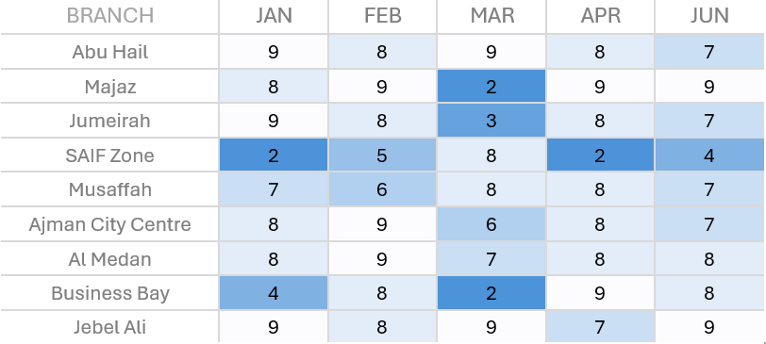
Choose appropriate visuals
B. Tables – Tables interact with our verbal system, which means that we read them.
Performance score of branches from Jan to Jun 2023.
Notes:
Notes:
Enhanced Table Visuals:
Key Information: Performance scores of branches from January to June 2023, with highlighted low scores.
Focus: The use of color highlights (e.g., blue) draws attention to the lower performance scores, making it easier to spot areas that need improvement without scanning the entire table in detail. This enhances the table’s effectiveness in conveying key insights.

Slide 29
Choose appropriate visuals
C. Graphs – Graphs interact with our visual system, which is faster at processing information.
Points
Lines
Bars
Area
Notes:
:
Graphs as Visuals:
Types Shown: Points, Lines, Bars, Area.
Focus: Graphs leverage our visual system’s ability to process information quickly. Different types of graphs are suited to different data storytelling needs:
Points: Best for individual data comparisons.
Lines: Ideal for showing trends over time.
Bars: Effective for comparing quantities.
Area: Useful for showing proportions or accumulations.

Slide 30
Choose appropriate visuals
Points
Scatter Plot – Useful for showing relationship between two variables.
Let’s say that we manage a bus fleet and want to understand the relationship between miles driven and cost per mile.
Miles
Notes:
Scatter Plot (Points):
Purpose: Useful for showing relationships between two variables, in this case, miles driven and cost per mile.
Example: This visual can help analyze patterns, such as how cost changes based on the number of miles driven for a bus fleet. The scatter plot visually emphasizes outliers and averages.

Slide 31
Choose appropriate visuals
Points
Scatter Plot – Useful for showing relationship between two variables.
Miles
Notes:
Scatter Plot (Points):
Purpose: Shows the relationship between two variables, highlighting patterns or outliers, such as the cost per mile relative to miles driven.
Focus: The highlighted points (in orange) emphasize higher costs at lower and higher mileages, with the average cost line helping to center the analysis on typical values. This visual is effective for spotting trends and deviations.

Slide 32
Choose appropriate visuals
Lines
Line Graph – Useful for plotting continuous data (time series data).
Notes:
Line Graphs (Lines):
Purpose: Ideal for plotting continuous data, especially over time (time series data).
Types Shown:
Single Series: Tracks one data set over time.
Two Series: Compares two data sets over the same time period.
Multiple Series: Allows for comparison across multiple data sets simultaneously, showing patterns or differences over time.
Focus: Line graphs are excellent for visualizing trends and changes.

Slide 33
Choose appropriate visuals
Lines
Slope graph – Useful for plotting two time periods or points of comparison showing relative increase or decrease effortlessly.
Employee feedback over time
Survey Category
Percent favorable
Peers
Culture
Work Environment
Let’s say you have analyzed employee feedback and wants to communicate the results.
Leadership
Career Development
48%
Rewards & Recognition
43%
Notes:
Slope Graph (Lines):
Purpose: Effective for comparing data between two time periods or points, clearly showing increases or decreases.
Example: Employee feedback scores from 2022 to 2023.
Focus: The slope graph highlights areas of improvement (e.g., Leadership) and areas of decline (e.g., Career Development and Rewards & Recognition), making it easy to track performance changes over time.

Slide 34
Choose appropriate visuals
Bars
Useful for showing categorical values.
Notes:
Bar Charts (Bars):
Purpose: Useful for displaying categorical data.
Types Shown:
Single Series: Displays values for one category set.
Two Series: Compares values across two different categories.
Multiple Series: Allows comparison across multiple categories simultaneously.
Focus: Bar charts are ideal for comparing quantities across categories, making it easier to see differences or similarities between groups.

Slide 35
Choose appropriate visuals
Area
Useful for visualizing numbers of vastly different magnitudes.
Out of 70 suppliers studied
25 suppliers qualified as important
9 top suppliers identified as critical
Notes:
Area Charts (Area):
Purpose: Useful for visualizing numbers of vastly different magnitudes.
Example: The chart shows 70 suppliers, 25 identified as important, and 9 marked as critical.
Focus: This type of visual makes it easy to compare the scale of different groups, such as highlighting critical suppliers within a larger pool of studied suppliers. The use of area gives a clear sense of proportion.

Slide 36
Choose appropriate visuals
Other Graphs
Graphs to be avoided – Pie chart, Donut chart, Shape charts, 3D charts, complex charts.
Group | Value
1 | 10
2 | 7.5
3 | 4
4 | 3
5 | 5
Group | Value
1 | 3
2 | 4
3 | 8
4 | 6
5 | 9
Notes:
Graphs to Avoid:
Pie charts, Donut charts, and 3D charts can be misleading or make comparisons difficult.
Example: The pie charts on the slide show percentages that are harder to compare accurately, especially with small segments.
Focus: Avoid complex or shape-based charts like these when simpler visuals (e.g., bar charts) can more clearly represent data and allow for better comparison between values.

Slide 37
Choose appropriate visuals
Other Graphs
Graphs to be avoided – Pie chart, Donut chart, Shape charts, 3D charts, complex charts.
Notes:
Notes:
Graphs to Avoid:
3D Pie Charts: These distort perception and make it difficult to accurately compare the market share between suppliers.
Focus: Avoid using 3D or shape-based charts like the ones shown here. Instead, use simpler visualizations (e.g., bar charts) to represent market share more clearly and allow for easier comparison between categories.

Slide 38
Choose appropriate visuals
Other Graphs
Graphs to be avoided – Pie chart, Donut chart, Shape charts, 3D charts, complex charts.
Notes:
Notes:
Graphs to Avoid:
Donut Charts: Similar to pie charts, donut charts make it difficult to compare relative sizes, especially with small segments.
Focus: Avoid using donut charts for precise comparisons. Opt for clearer alternatives like bar charts that offer better readability and make it easier to distinguish between categories, such as supplier market share in this example.

Slide 39
Choose appropriate visuals
Other Graphs
Graphs to be avoided – Pie chart, Donut chart, Shape charts, 3D charts, complex charts.
Notes:
Notes:
Graphs to Avoid:
3D Bar Charts: The left chart uses a 3D effect, which can distort the perception of bar heights, making comparisons between values harder.
Focus: Avoid 3D charts and opt for simpler 2D bar charts, as shown on the right, for a clearer and more accurate representation of data. The 2D version eliminates unnecessary visual distortions and makes it easier to compare values across months.

Slide 40
Recap what we learned…
For one or two numbers – use text.
Tables interact with our verbal system, which means that we read them.
Graphs interact with our visual system, which is faster at processing information.
4 Classifications: Point, Lines, Bars, Area charts
Avoid Pie chart, donut chart, 3D chart, etc.
Notes:
Notes:
Recap of Key Learnings:
Use text for communicating one or two key numbers.
Tables are effective for verbal interaction and reading detailed data.
Graphs work well with the visual system for faster processing of data.
Four main classifications of visuals: Point, Lines, Bars, Area.
Avoid using Pie charts, Donut charts, 3D charts, and other complex visuals for better clarity.

Slide 41
Exercise – Choose appropriate visual
Notes:
Notes:
Exercise: Focus on choosing the most appropriate visual for the data at hand.
Key Consideration: Apply the principles discussed—choose visuals based on the type of data (categorical, time-series, comparison) and avoid unnecessary complexity (e.g., pie charts, 3D visuals) to ensure clarity and effectiveness in communication.

Slide 42
Remove clutter from visuals
Notes:
Notes:
Key Message: Simplify visuals by removing unnecessary elements that do not add value to the data story.
Focus: Eliminate gridlines, excessive labels, decorative elements, and other clutter to ensure the audience focuses on the most important insights without distractions.

Slide 43
Every single element is a cognitive load on your audience
10
9
8
7
6
5
4
3
2
1
0
x
Text1
Text 2
Text 3
Text 4
x
x
x
JAN
FEB
MAR
APR
MAY
Notes:
Notes:
Key Message: Each visual element adds cognitive load to the audience.
Focus: This chart demonstrates unnecessary elements, such as extra labels, markers, shading, and text, which can distract from the key message. Simplify visuals to reduce cognitive load and help the audience focus on the essential data insights.

Slide 44
Remove clutter from visuals
Gestalt’s Principles of Visual Perception
It helps you understand how your audience sees and allows you to identify and remove unnecessary visual.
Enclosure
Continuity
Proximity
Similarity
Closure
Connection
Notes:
Notes:
Gestalt's Principles of Visual Perception:
Key Principles: Proximity, Similarity, Enclosure, Closure, Continuity, Connection.
Focus: These principles help in understanding how the audience processes visuals. By applying these principles, you can identify unnecessary elements and simplify your visuals, making them more intuitive and easier to understand.

Slide 45
Remove clutter from visuals
Gestalt’s Principles of Visual Perception
Ω Ω Ω
Ω Ω Ω
Ω Ω Ω
Ω Ω Ω
Ω Ω Ω
Ω Ω Ω
Ω Ω Ω
……
……
……
Proximity
Principle of Proximity
Notes:
Gestalt’s Principle of Proximity:
Key Concept: Objects that are close to one another are perceived as part of the same group.
Focus: Utilize proximity to naturally organize information, allowing viewers to quickly group related elements without the need for additional lines or markers. This reduces clutter and enhances visual clarity.

Slide 46
Remove clutter from visuals
Gestalt’s Principles of Visual Perception
Ω Ω Ω Ω
Ω Ω Ω Ω
Ω Ω Ω Ω
Ω Ω Ω Ω
Ω Ω Ω Ω
Similarity
Principle of Similarity
Notes:
Notes:
Gestalt’s Principle of Similarity:
Core Idea: Elements that are visually similar (in shape, color, or size) are perceived as related or grouped.
Focus: Use similarity to organize data visually. By making related items look similar, you reduce clutter and help the audience quickly identify patterns or relationships in the data.

Slide 47
Remove clutter from visuals
Gestalt’s Principles of Visual Perception
……
……
……
Ω Ω Ω Ω
Ω Ω Ω Ω
Ω Ω Ω Ω
Ω Ω Ω Ω
Ω Ω Ω Ω
Enclosure
Principle of Enclosure
Notes:
Gestalt’s Principle of Enclosure:
Core Idea: Elements enclosed by a boundary are perceived as a group.
Focus: Use enclosures like boxes or shading to visually group related elements, making it easier for the audience to understand relationships and reducing clutter by naturally guiding their attention to specific areas.

Slide 48
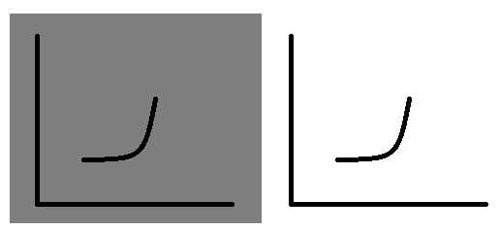

Remove clutter from visuals
Gestalt’s Principles of Visual Perception
Closure
Principle of Closure
Chart with enclosure and without enclosure
Notes:
Notes:
Gestalt’s Principle of Closure:
Core Idea: The mind tends to complete incomplete shapes to form a whole.
Focus: Use the principle of closure to imply boundaries without explicitly drawing them. This can help reduce visual clutter while still conveying structure, allowing the audience to interpret the visual with minimal distractions.

Slide 49
Remove clutter from visuals
Gestalt’s Principles of Visual Perception
Continuity
Continuity seen in the Y-axis without an actual axis line present.
Principle of Continuity
Notes:
Notes:
Gestalt’s Principle of Continuity:
Core Idea: Elements arranged on a line or curve are perceived as more related than those not on the line.
Focus: Continuity helps guide the viewer's eye along a path, such as following the bar lengths in the market share example. You can reduce visual clutter by implying structure (like an axis) without explicitly including it, allowing for a cleaner design while still ensuring clarity.

Slide 50
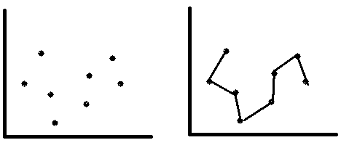
Remove clutter from visuals
Gestalt’s Principles of Visual Perception
Connection
Principle of Connection
Lines connecting the dots
Notes:
Gestalt’s Principle of Connection:
Core Idea: Elements that are visually connected (by lines or other features) are perceived as related.
Focus: Use connections like lines to group related data points or guide the viewer's interpretation. This can help convey relationships more clearly without adding unnecessary visual clutter, as demonstrated by connecting dots in a scatter plot.

Slide 51
Remove clutter from visuals
Survey shows that demonstration of results is the single most important dimension when choosing a service provider.
Survey feedback about factors considered by nonprofits in vendor selection.
Affordability and experience working together previously, which were hypothesized to be very important in decision making process, were both cited less frequently as important attributes.
Data sources: xyz; includes N number of survey respondents. Note that respondents were able to choose up to 3 options.
Notes:
Notes:
Survey Feedback Visualization:
Key Message: "Demonstration of results" is the most important factor considered by nonprofits when selecting a vendor.
Focus: The chart clearly shows the importance of different attributes, with annotations guiding the audience to key insights. The visual avoids clutter by using clear labels and focusing on the most significant findings, enhancing comprehension.

Slide 52
3. Remove clutter from visuals
Demonstrating effectiveness is most important consideration when selecting a provider.
% selecting given attribute
In general, what attributes are the most important to you in selecting a service provider? (choose up to 3).
Survey shows that demonstration of results is the single most important dimension when choosing a service provider.
Data sources: xyz; includes N number of survey respondents. Note that respondents were able to choose up to 3 options.
Affordability and experience working together previously, which were hypothesized to be very important in decision making process, were both cited less frequently as important attributes.
Notes:
Notes:
Survey Results Visualization:
Key Insight: "Demonstration of results" is the top priority when selecting a provider, cited by the majority of respondents.
Focus: The chart uses minimal clutter with clear labels and effective use of space to highlight key survey findings, particularly drawing attention to the top attributes that matter most to nonprofits in vendor selection.

Slide 53
3. Remove clutter from visuals
Demonstrating effectiveness is most important consideration when selecting a provider.
% selecting given attribute
In general, what attributes are the most important to you in selecting a service provider? (choose up to 3).
Survey shows that demonstration of results is the single most important dimension when choosing a service provider.
Data sources: xyz; includes N number of survey respondents. Note that respondents were able to choose up to 3 options.
Affordability and experience working together previously, which were hypothesized to be very important in decision making process, were both cited less frequently as important attributes.
Notes:
Notes:
Key Insight: "Demonstration of results" is the most important factor when selecting a provider, cited by a large majority of respondents.
Focus: The visual is clear and uncluttered, using bars and annotations to emphasize the most relevant insights, particularly highlighting how certain hypothesized important factors, like affordability, were less frequently selected than expected.

Slide 54
3. Remove clutter from visuals
Demonstrating effectiveness is most important consideration when selecting a provider.
% selecting given attribute
In general, what attributes are the most important to you in selecting a service provider? (choose up to 3).
Survey shows that demonstration of results is the single most important dimension when choosing a service provider.
Data sources: xyz; includes N number of survey respondents. Note that respondents were able to choose up to 3 options.
Affordability and experience working together previously, which were hypothesized to be very important in decision making process, were both cited less frequently as important attributes.
Notes:
Notes:
Key Insight: "Demonstration of results" is the most critical factor in provider selection, standing out clearly in the visual.
Focus: The use of color highlights the most important attributes (demonstration of results and content expertise) while de-emphasizing less critical ones (affordability, previous work together), guiding the audience to focus on the main takeaway without clutter.

Slide 55
3. Remove clutter from visuals
Demonstrating effectiveness is most important consideration when selecting a provider.
% selecting given attribute
In general, what attributes are the most important to you in selecting a service provider? (choose up to 3).
Survey shows that demonstration of results is the single most important dimension when choosing a service provider.
Data sources: xyz; includes N number of survey respondents. Note that respondents were able to choose up to 3 options.
Affordability and experience working together previously, which were hypothesized to be very important in decision making process, were both cited less frequently as important attributes.
Notes:
Notes:
Key Insight: "Demonstration of results" ranks as the top priority for service provider selection, with over 70% of respondents selecting it.
Focus: The use of color to emphasize important findings (e.g., demonstration of results in blue, affordability in orange) helps direct attention to the key messages, while less significant factors are de-emphasized, maintaining clarity and reducing clutter.

Slide 56
3. Remove clutter from visuals
Demonstrating effectiveness is most important consideration when selecting a provider.
% selecting given attribute
In general, what attributes are the most important to you in selecting a service provider? (choose up to 3).
Survey shows that demonstration of results is the single most important dimension when choosing a service provider.
Data sources: xyz; includes N number of survey respondents. Note that respondents were able to choose up to 3 options.
Affordability and experience working together previously, which were hypothesized to be very important in decision making process, were both cited less frequently as important attributes.
Notes:
Notes:
Key Insight: "Demonstration of results" is the most important factor in selecting a service provider, as highlighted by over 70% of respondents.
Focus: Color emphasis on critical insights (blue for "Demonstration of results" and orange for "Affordability and experience") helps prioritize key takeaways, while the layout remains clean and free of unnecessary visual elements, ensuring clarity.

Slide 57
3. Remove clutter from visuals
Demonstrating effectiveness is most important consideration when selecting a provider.
% selecting given attribute
In general, what attributes are the most important to you in selecting a service provider? (choose up to 3).
Survey shows that demonstration of results is the single most important dimension when choosing a service provider.
Data sources: xyz; includes N number of survey respondents. Note that respondents were able to choose up to 3 options.
Affordability and experience working together previously, which were hypothesized to be very important in decision making process, were both cited less frequently as important attributes.
Notes:
Notes:
Key Insight: The "Demonstration of results" is the top factor for selecting a service provider, cited by the highest percentage of respondents.
Focus: The visual uses a clear, uncluttered bar chart to emphasize the top factors, with the use of color and annotations guiding the audience's attention to the most important attributes while minimizing distractions.

Slide 58
3. Remove clutter from visuals
Alignment: Helps in making a clear layer for reading the text (z reading). Diagonal elements make reading slower.
White Space: Also known as the visual ‘pause’. Aim should be to preserve white spaces as much as possible and use it for ‘Emphasis’.
Notes:
Notes:
Alignment: Ensures clear and efficient reading by guiding the viewer's eye in a logical flow (e.g., Z-pattern). Avoid diagonal elements that can slow reading.
White Space: Known as a visual "pause," it helps to emphasize key elements and should be preserved to prevent clutter and enhance focus.

Slide 59
3. Remove clutter from visuals
Decluttering in Steps:
Exercise:
Prepare a chart and remove the clutter by following the Gestalt's Principles of Visual Perception.
Step 1: Remove chart border
Step 2: Remove gridlines
Step 3: Remove data markers
Step 4: Clean up axis labels
Step 5: Label data directly
Step 6: Leverage consistent color
Notes:
Notes:
Exercise: Declutter a chart by following these steps:
Remove unnecessary chart borders.
Eliminate gridlines to reduce visual distractions.
Remove extra data markers.
Simplify axis labels.
Directly label data points for clarity.
Use a consistent color scheme to maintain focus and coherence.
This step-by-step approach helps apply Gestalt’s principles to streamline visuals effectively.

Slide 60
Recap what we learned…
Every single element in your chart is a cognitive load on your audience.
Gestalt’s Principles of Visual Perception.
Importance of Alignment & White space.
Decluttering Steps.
Notes:
Notes:
Key Learnings Recap:
Every element in a chart adds cognitive load to your audience.
Gestalt’s Principles of Visual Perception help in organizing and simplifying visuals.
Importance of alignment and white space for readability and focus.
Step-by-step approach to decluttering charts for clearer communication.

Slide 61
Direct audience’s focus on visuals
Notes:
Notes:
Key Message: Focus on directing the audience’s attention to the most important parts of your visuals.
Focus: Use techniques like color contrast, annotations, and layout to emphasize key insights and guide your audience's eye to where it matters most in the data.

Slide 62
Direct audience’s focus on your visuals
Use Pre-attentive attributes as tools for directing your audience’s focus on the visuals.
Pre-attentive attributes:
Position
Color
Orientation
Size
Shape
Movement, etc.
It can be used strategically in two ways:
To direct audience’s attention to where you want them to focus.
To create a visual hierarchy of elements in the way you want your audience to process the information.
Notes:
Notes:
Pre-attentive Attributes are key tools to direct the audience’s focus in visuals. These include:
Position
Color
Orientation
Size
Shape
Movement
Usage:
Direct audience focus to specific areas of the visual.
Create a visual hierarchy to guide how the audience processes the information.

Slide 63
Pre-attentive attributes signal where to look
756395068473
658663037576
860372658602
846589107830
756395068473
658663037576
860372658602
846589107830
Count 3s in the example
Count 3s in the example
Notes:
Notes:
Pre-attentive Attributes in Action:
This slide demonstrates how pre-attentive attributes like color and size make it easier and faster to identify specific information (in this case, counting the number of 3s).
Focus: These attributes help direct the audience’s attention to the most relevant parts of the data, improving clarity and speed of comprehension.

Slide 64
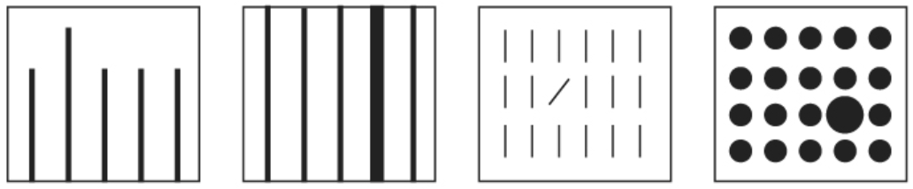
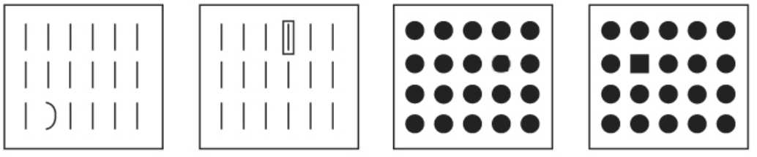
Pre-attentive attributes signal where to look
Length
Width
Orientation
Size
Curvature
Enclosure
Blur
Shape
Notes:
Notes:
Pre-attentive Attributes: The slide demonstrates various visual attributes (e.g., length, width, orientation, size, curvature, enclosure, blur, shape) that can be used to signal where the audience should focus.
Focus: These attributes help guide the viewer's attention quickly and efficiently, making it easier to identify key information in a visual representation.

Slide 65
Pre-attentive attributes signal where to look
Color
Use color sparingly.
Be thoughtful of the colors used.
Use consistent colors.
Design considering colorblindness in people.
Be thoughtful of the tone the color conveys.
Brand Colors can be leveraged selectively.
Position
Use the z reading to your advantage.
Use takeaways or call for action on the top.
Be mindful of the positioning the elements in your visualization.
Notes:
Notes:
Color:
Use color sparingly and thoughtfully.
Ensure consistency, consider colorblindness, and be aware of the emotional tone conveyed by colors.
Leverage brand colors selectively for emphasis.
Position:
Use the Z-pattern for reading flow.
Place key takeaways or actions at the top.
Be mindful of the positioning of elements to guide the audience’s focus effectively.

Slide 66
Pre-attentive attributes signal where to look
Graph without pre-attentive attributes
Graph without pre-attentive attributes
Notes:
Notes:
Demonstrating the Impact of Pre-attentive Attributes:
The left chart lacks pre-attentive attributes, making it harder to interpret key insights.
The right chart uses color and annotations to highlight an important data point—a significant revenue dip in March—making it easier for the audience to focus on the critical information.

Slide 67
Recap what we learned…
Pre-attentive attributes
Key attributes include color, size, position.
Test to ensure your pre-attentive attributes guide the audience's focus as intended.
Notes:
Notes:
Recap of Key Learnings:
Pre-attentive attributes (color, size, position) help guide the audience’s focus.
These attributes are crucial for ensuring that the audience sees and processes the most important information first.
Always test to ensure pre-attentive attributes are directing focus as intended.

Slide 68
Show designing skills
Notes:
Notes:
Key Message: This slide introduces the importance of showcasing design skills when creating visualizations.
Focus: Effective design principles, such as minimalism, clarity, and thoughtful use of pre-attentive attributes, are essential for creating visuals that communicate data clearly and engage the audience.

Slide 69
Show designing skills
FORM FOLLOWS FUNCTION.
Highlight the important elements. Consider some tools –
Bold, italics and underline
CASE & typeface
Color
Inversing elements
Size
Notes:
Notes:
Form Follows Function: Design should always prioritize functionality and clarity.
Tools for Highlighting Elements:
Bold, italics, underline
Case and typeface
Color and inversing elements
Size
These design tools help emphasize important information, guiding the audience’s attention to key parts of the visual.

Slide 70
Show designing skills
Affordances
Eliminate distractions
Not all data are equally important.
When detail is not needed, summarize it.
Ask yourself: if eliminating some element would change something important?
Push necessary but non-message impacting items to the background.
Notes:
Notes:
Affordances in Design:
Eliminate distractions and focus on essential data.
Recognize that not all data is equally important—summarize when detail is unnecessary.
Consider the impact of removing elements: will it affect understanding?
Push non-critical, background elements to secondary importance to maintain focus on key messages.

Slide 71
Show designing skills
Accessibility
Create a clear visual hierarchy of information.
Make it legible: use a consistent, easy‐to‐read font (consider both typeface and size).
Keep it clean: make your data visualization approachable.
Use straightforward language: choose simple language over complex, choose fewer words over more words.
Remove unnecessary complexity: when making a choice between simple and complicated, favor simple.
Notes:
Notes: Accessibility in Design:
Establish a clear visual hierarchy to guide the audience's attention.
Ensure legibility by selecting easy-to-read fonts and maintaining consistency in typeface and size.
Keep visuals clean and approachable for the audience.
Opt for simple, concise language instead of complexity.
Remove unnecessary complexity; favor simplicity to enhance comprehension.

Slide 72
Show designing skills
Aesthetics
Aesthetic designs are perceived as easier to use and are more likely to be accepted and used over time.
They promote creativity, problem-solving, and foster positive relationships.
Good aesthetics can make users more tolerant of flaws.
Example: A well-designed but leaky bottle was still popular due to its appealing look.
Key Elements of Aesthetic Data Visualization
Color: Use color sparingly and intentionally to highlight important data.
Alignment: Ensure elements are aligned to create a sense of unity and cohesion.
White Space: Use white space wisely to avoid clutter and make visuals comfortable to view.
Notes:
Notes: Aesthetics in Design:
Aesthetic designs are easier to use and more likely to be accepted over time.
They encourage creativity, problem-solving, and foster positive user relationships.
Good aesthetics can make users more forgiving of flaws.
Example: A visually appealing but flawed product may still be popular due to its design.
Key Elements of Aesthetic Data Visualization:
Color: Use color sparingly and purposefully to emphasize critical data.
Alignment: Align elements to create unity and cohesion.
White Space: Utilize white space effectively to reduce clutter and improve readability.

Slide 73
Show designing skills
Acceptance
People often resist changes due to familiarity with existing designs, making it difficult to introduce new data visualizations.
Strategies for Gaining Acceptance:
Articulate Benefits: Explain the advantages of the new approach to ease discomfort.
Show Side-by-Side Comparisons: Demonstrate the superiority of the new design with before-and-after visuals.
Provide Multiple Options: Engage your audience by offering several design choices and seeking their input.
Notes:
Notes: Acceptance in Design:
Resistance to change is common due to familiarity with current designs, which can make introducing new data visualizations challenging.
Strategies for Gaining Acceptance:
Articulate Benefits: Clearly explain the advantages of the new approach to ease discomfort.
Side-by-Side Comparisons: Show before-and-after visuals to highlight improvements in the new design.
Provide Multiple Options: Engage your audience by offering several design choices and gathering their input.

Slide 74
Show designing skills
Acceptance
Building Support and Addressing Resistance:
Engage Influential Members: Gain acceptance by securing the support of vocal and influential audience members.
Test with a Neutral Party: Get feedback from someone outside the decision-making process to identify any design issues.
Refine and Communicate: Use insights from unbiased feedback to refine your design and strengthen your argument for adoption.
Notes:
Notes: Recap of Design Principles
Form follows function: Ensure that design serves its intended purpose.
Highlighting tools: Use tools like bold, italics, color, and size to emphasize important elements.
Eliminate distractions: Remove unnecessary elements to improve focus.
Visual hierarchy: Create a clear structure that guides the viewer's attention.
Usability: Design with the user's needs in mind for easy interaction.
Visual appeal: Make the design aesthetically pleasing.
Audience acceptance: Ensure the design is welcomed and understood by the audience.

Slide 75
Recap what we learned…
Form follows function.
Consider highlighting tools.
Eliminate distractions.
Create a clear visual hierarchy of information.
Design that is usable by people.
Make it visually appealing.
Make designs that are accepted by audience.
Notes:
Notes: Recap of Design Principles
Form follows function: Ensure design serves its purpose.
Highlighting tools: Consider using bold, italics, color, and size to emphasize key elements.
Eliminate distractions: Remove unnecessary elements to maintain focus.
Visual hierarchy: Organize information clearly, guiding the viewer’s attention.
Usability: Make sure the design is accessible and user-friendly.
Visual appeal: Aesthetic designs are more likely to be well-received.
Audience acceptance: Create designs that are understood and appreciated by your audience.

Slide 76
Exercise: Designer Skills
Notes:
Notes: Exercise: Designer Skills This slide indicates a practical exercise where participants will apply the concepts learned related to designer skills, focusing on aspects like form, function, highlighting tools, and creating clear, visually appealing designs.

Slide 77
Notes:
Notes: This slide depicts a Huge Dip in Sales after a period of Continued Growth, indicating a significant drop in May due to unseasonal economic factors. The slide emphasizes the sharp decline in sales, but notes that sales have since fully recovered in June, with growth expected to continue. The visual focuses on the contrast between growth and the dip, with a 6% decrease highlighted.

Slide 78
Tell your story
Notes:
Notes: This slide focuses on the importance of storytelling in presentations. It encourages the presenter to tell a compelling story that engages the audience and effectively conveys the message.

Slide 79
Tell your story
Facts
Dystopian Earth, global famine, and agricultural collapse.
Astronaut team, led by Joseph Cooper, embarks on a mission through a Saturn-adjacent wormhole.
Exploration of potentially habitable planets with consideration of time dilation and relativistic effects.
Emphasis on scientific concepts such as black holes, particularly Gargantua, and their gravitational impact.
Interweaving of theoretical physics, multidimensional space, and the relationship between love and gravity.
Adherence to scientific accuracy in a hard science fiction framework.
Complex resolution involving the interplay of time, space, and human connection within the confines of theoretical physics.
Notes:
Notes: This slide presents facts related to a narrative or story. It outlines key plot points or scientific concepts, emphasizing the blend of science and storytelling through topics like time dilation, relativity, black holes, and the interplay between love and physics. The slide underscores the importance of scientific accuracy within a science fiction framework.

Slide 80
Tell your story
Story
"In a dystopian future where Earth faces environmental collapse and dwindling resources, former NASA pilot Joseph Cooper is recruited for a last-ditch space mission. A mysterious wormhole near Saturn offers hope for humanity's survival, leading Cooper and a team of astronauts to explore potentially habitable planets in distant galaxies. As they navigate the complexities of time dilation and gravitational forces, the crew encounters black holes and the enigmatic Gargantua. Meanwhile, the emotional bonds between Cooper and his family transcend space. The story weaves together hard science fiction and human emotion, culminating in a cosmic journey that challenges the boundaries of love, time, and the resilience of the human spirit."
Notes:
Notes: This slide provides a story summary set in a dystopian future where humanity faces environmental collapse. The plot follows Joseph Cooper, a former NASA pilot, on a mission to explore habitable planets via a wormhole near Saturn, hoping to ensure the survival of mankind. The narrative blends science fiction with human emotion, focusing on concepts like time dilation, gravitational forces, and the bond between Cooper and his family, particularly as they transcend time and space.

Slide 81
Tell your story
Constructing the Story
Storyboarding!
3-minute story and the Big Idea!
The beginning, the middle and the end.
Keep the audience in mind.
The beginning:
1. The setting: When and where does the story take place?
2. The main character: Who is driving the action?
3. The imbalance: Why is it necessary, what has changed?
4. The balance: What do you want to see happen?
5. The solution: How will you bring about the changes?
Notes:
Notes: This slide emphasizes the key components of story construction:
Storyboarding is a key method to visualize the narrative.
Focus on a 3-minute story and delivering the Big Idea concisely.
Structuring the story with a beginning, middle, and end, while always keeping the audience in mind.
The Beginning addresses five questions:
Setting: Where and when does the story take place?
Main Character: Who is driving the action?
Imbalance: What changes have occurred, making action necessary?
Balance: What outcome do you want to achieve?
Solution: How will the changes be brought about?

Slide 82
Tell your story
The middle:
Further develop the situation or problem by covering relevant background.
Incorporate external context or comparison points.
Give examples that illustrate the issue.
Include data that demonstrates the problem.
Articulate what will happen if no action is taken or no change is made.
Discuss potential options for addressing the problem.
Illustrate the benefits of your recommended solution.
Make it clear to your audience why they are in a unique position to make a decision or drive action.
Notes:
Notes: This slide focuses on developing the middle part of the story. It involves:
Expanding on the situation or problem, providing necessary background.
Adding external context or comparisons to deepen understanding.
Using examples to illustrate the issue.
Presenting data that highlights the problem.
Explaining the consequences of inaction.
Discussing possible solutions or options.
Showing the benefits of the recommended solution.
Highlighting the audience's unique position to take action or make decisions.

Slide 83
Tell your story
The end:
End with a call for action.
A quick recap of the problem, resulting need for action, reiterating a sense of urgency, and action call must be followed.
Notes:
Notes: This slide outlines the ending of the story with two key points:
Call to action: End the story by urging the audience to take specific action.
Recap the problem: Reinforce the urgency of the situation by summarizing the problem and the need for action, ensuring the audience understands that following through is critical.

Slide 84
Data Storytelling & Decision-Making Journey:
Know about the context.
Choose appropriate visuals.
Remove the clutter from visuals.
Direct audience’s focus on your visuals.
Show your designing skills.
Tell your story.
Notes:
Notes: This slide outlines the Data Storytelling & Decision-Making Journey with six key steps:
Know about the context – Understand the background and purpose before crafting visuals.
Choose appropriate visuals – Select visuals that best communicate the message.
Remove the clutter from visuals – Eliminate unnecessary elements to avoid overwhelming the audience.
Direct audience’s focus on your visuals – Use pre-attentive attributes to guide attention.
Show your designing skills – Apply design principles to enhance clarity and engagement.
Tell your story – Present the information in a clear, engaging narrative that drives decision-making.

Slide 85
Case Study
Notes:
Notes: This slide introduces the Case Study section, signaling a shift in the presentation to a practical example or real-world application of the concepts discussed previously.

Slide 86
Case 1
Case 2
As a HR Business partner, you want to understand and communicate how employee headcount has changed
over the past year for the client group, you support.
Create a chart to show how the headcount has affected.
As a Finance Manager, you are asked by the Marketing Manager to increase the budget for new marketing campaigns. You are tasked to get approval from the top management of your organization to increase the budget of marketing.
Create a suitable chart for getting approval of a new budget.
Notes:
Notes: Case 1: You are tasked with analyzing employee headcount as an HR Business partner and creating a chart to visualize changes over the past year for a client group you support.
Case 2: As a Finance Manager, you need to create a chart that will help get approval for increasing the marketing budget, working with the Marketing Manager to convince top management.

Slide 87
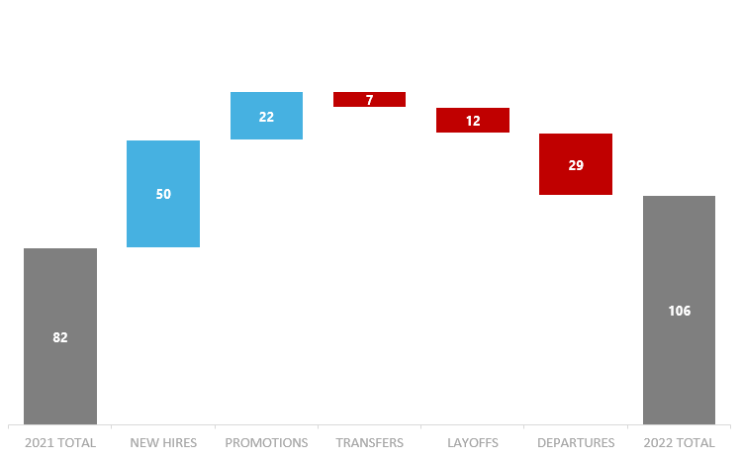
Sales Manager headcount increased by 29%
2022 Headcount Metrics
Aggressive hiring has increased the overall headcount in 2022 by 29% even though there were more departures.
Notes:
Notes: The slide presents the 2022 Headcount Metrics, highlighting a 29% increase in Sales Manager headcount. Key factors include aggressive hiring practices that offset layoffs and departures. Specific metrics:
82 (2021 Total)
50 New Hires
22 Promotions
7 Transfers
12 Layoffs
29 Departures
106 (2022 Total)

Slide 88
Allocate additional funds to Marketing budget for new campaigns
New budget range should be USD 450,000
Notes:
This slide highlights the need to allocate additional funds for the marketing budget, increasing it to USD 450,000 due to actual marketing expenses exceeding the budgeted amounts. The bar chart compares the "Actual Expenses of Marketing" with the "Budgeted Expenses of Marketing," showing a gap. Other categories like "Employees," "Office Space," "Transport," and "Other" are also represented to provide a comprehensive view of overall expenses. The focus is on the necessity to approve the higher marketing budget for future campaigns to align with actual expenses.

Slide 89

How to download course materials
Go to https://live.eibfs.ae or scan the QR code.
Log in using your username and password.
Find your course by its title.
Right-click the content and select "Save As."
Download the materials to your computer.

Slide 90
How to complete course feedback
Go to https://live.eibfs.ae or scan the QR code.
Log in using your username and password.
Find your course by its title.
Click on the “Feedback”
Complete the survey.
Feedback form completion is a mandatory requirement to receive the certificate.

Slide 91


